Slide 1
Physics 1 – Nov 6, 2018
P3 Challenge – A 1.50 kg pail is pulled upward with a rope with an acceleration of 1.35 m/s². What is the tension in the rope?
Today’s Objective: Second Law Problem Solving (frictionless)
Get out Second Law Worksheet for HMK check

Slide 2
Agenda, Assignment
IB 2.2 Forces
Second Law Problems (frictionless)
Agenda
Homework review on WB
Another Sample problem
Extra Second Law Practice in WB groups
Assignment:
Extra Second Law Practice #23 - 32

Slide 3
Typical Second Law Problem Solving
1) Draw the system. Label with masses and Forces and any other data.
2) Choose the body of interest (to be treated as a point mass) and a frame of reference.
3) Draw the Free Body Diagram, including all forces acting on the body of interest. Include the direction for each.
4) Resolve all forces at an angle into their x and y components.
5) Write the expression for the net force in each dimension (F_{net,x} = Right – left, F_{nety} = Up – down)
6) Write the second law equation for each dimension F_{net,x} = ma_{x} F_{nety} = ma_{y}
7) (Opt first or last step) Connect to kinematics through acceleration.

Slide 4
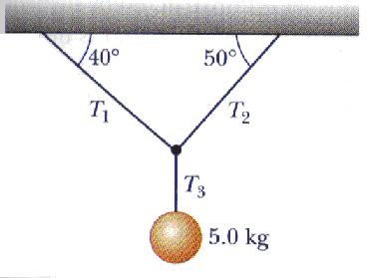
Sample 2nd Law Problem
Determine the three tensions.

Slide 5
Exit Slip - Assignment
How do you know whether to set F_{net} = 0 or F_{net} = ma?
What’s Due? (Pending assignments to complete.)
Complete Extra 2nd Law Practice #23 – 32
What’s Next? (How to prepare for the next day)
Read p57-75

